Slide 1


Training, certification and clarity processes
Operations team
05.06.23

Slide 2

Ops team
What comes to mind when you think of us?
  Ops Reviews
  Time Logs
  Human Resources
  Training and Certifications

Slide 3

Finances
For Clarity:
  Payroll and Compensation Plans
  Business Expenses Management
  Reporting & Accountability around Clarity’s financial goals for both income and expenditures
For Our Clients:
  Invoicing and Budget Planning
Administration
Tasks Include:
  Information conduit between all departments
  Documentation and delegation of tasks
  HR Management
  Audits (not just time logs! Haha)
  Calendar Planning
  Event Planning

Slide 4

Recruiting
For Clarity:
  Sourcing candidates
  Ensuring process is followed
  Scheduling & Coordinating
  Preparation of materials
For Candidates:
  Main point of contact
  Questions & Information about Clarity
Training & Certifications
Create & Update LMS Courses based on latest processes & products
Working with Leadership to identify areas of opportunity within Clarity to promote career growth and continuing education

Slide 5


Career Growth
How to Fill Out Leapsome Assessments
Why It’s Important
Be proud!
  Highlight your successes, accomplishments and good work.
Be honest and critical
  Point out what could have been done better and how you plan to improve.
Be specific
  Bring in any details that help describe your performance.
Allows team members to reflect on their accomplishments and errors made in the past
Acts as a driving force for self-motivation
Reminds managers of the team member’s achievements and challenges
Helps both the team member and manager understand why
each score was chosen

Slide 6

Tips & Tricks for maximizing time with Chris
Take In-Detail Notes or Transcribe the Meeting
Come with a plan and written agenda
  This includes possible solutions to your blockers
Be prepared to share your screen
Repeat back action items at the end of the meeting
Don’t forget to use the CR Meeting Request Channel

Slide 7



Best practices on working from home
Your Office Space
Make sure your work station is in an area of your home that you thrive in
Clean and maintain your desk area so as not to get overwhelmed by your space
Personalize your work station to feel welcoming
Your Schedule
Make a to-do list for your full day
Decide which time in the core hours you work best and put priority items to be done in those hours
Put a few blocks in your calendar to remember to complete a task
Take a small break to walk, stretch your legs, or get some fresh air
Teams/Outlook Tips
Pre-send Teams Messages that you know will have to go out in advance
If you are in a different time zone: Include 2 time zones on your calendar (Your time zone and central zone)
Pre-send emails that you know will need to be sent in advance
Use email and calendar categories to color-code your meetings and conversations

Slide 8

Training & Certification UPdates
Looking Ahead
Completed Certifications:
  Onboarding Certifications for both FE & BE CEF
  Mid-Level Certifications for both FE & BE CEF
  Sr. Level Developer Certification
In Progress:
  PM Onboarding Certification
  Connect Onboarding Certification

Slide 9
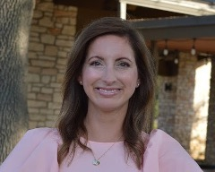
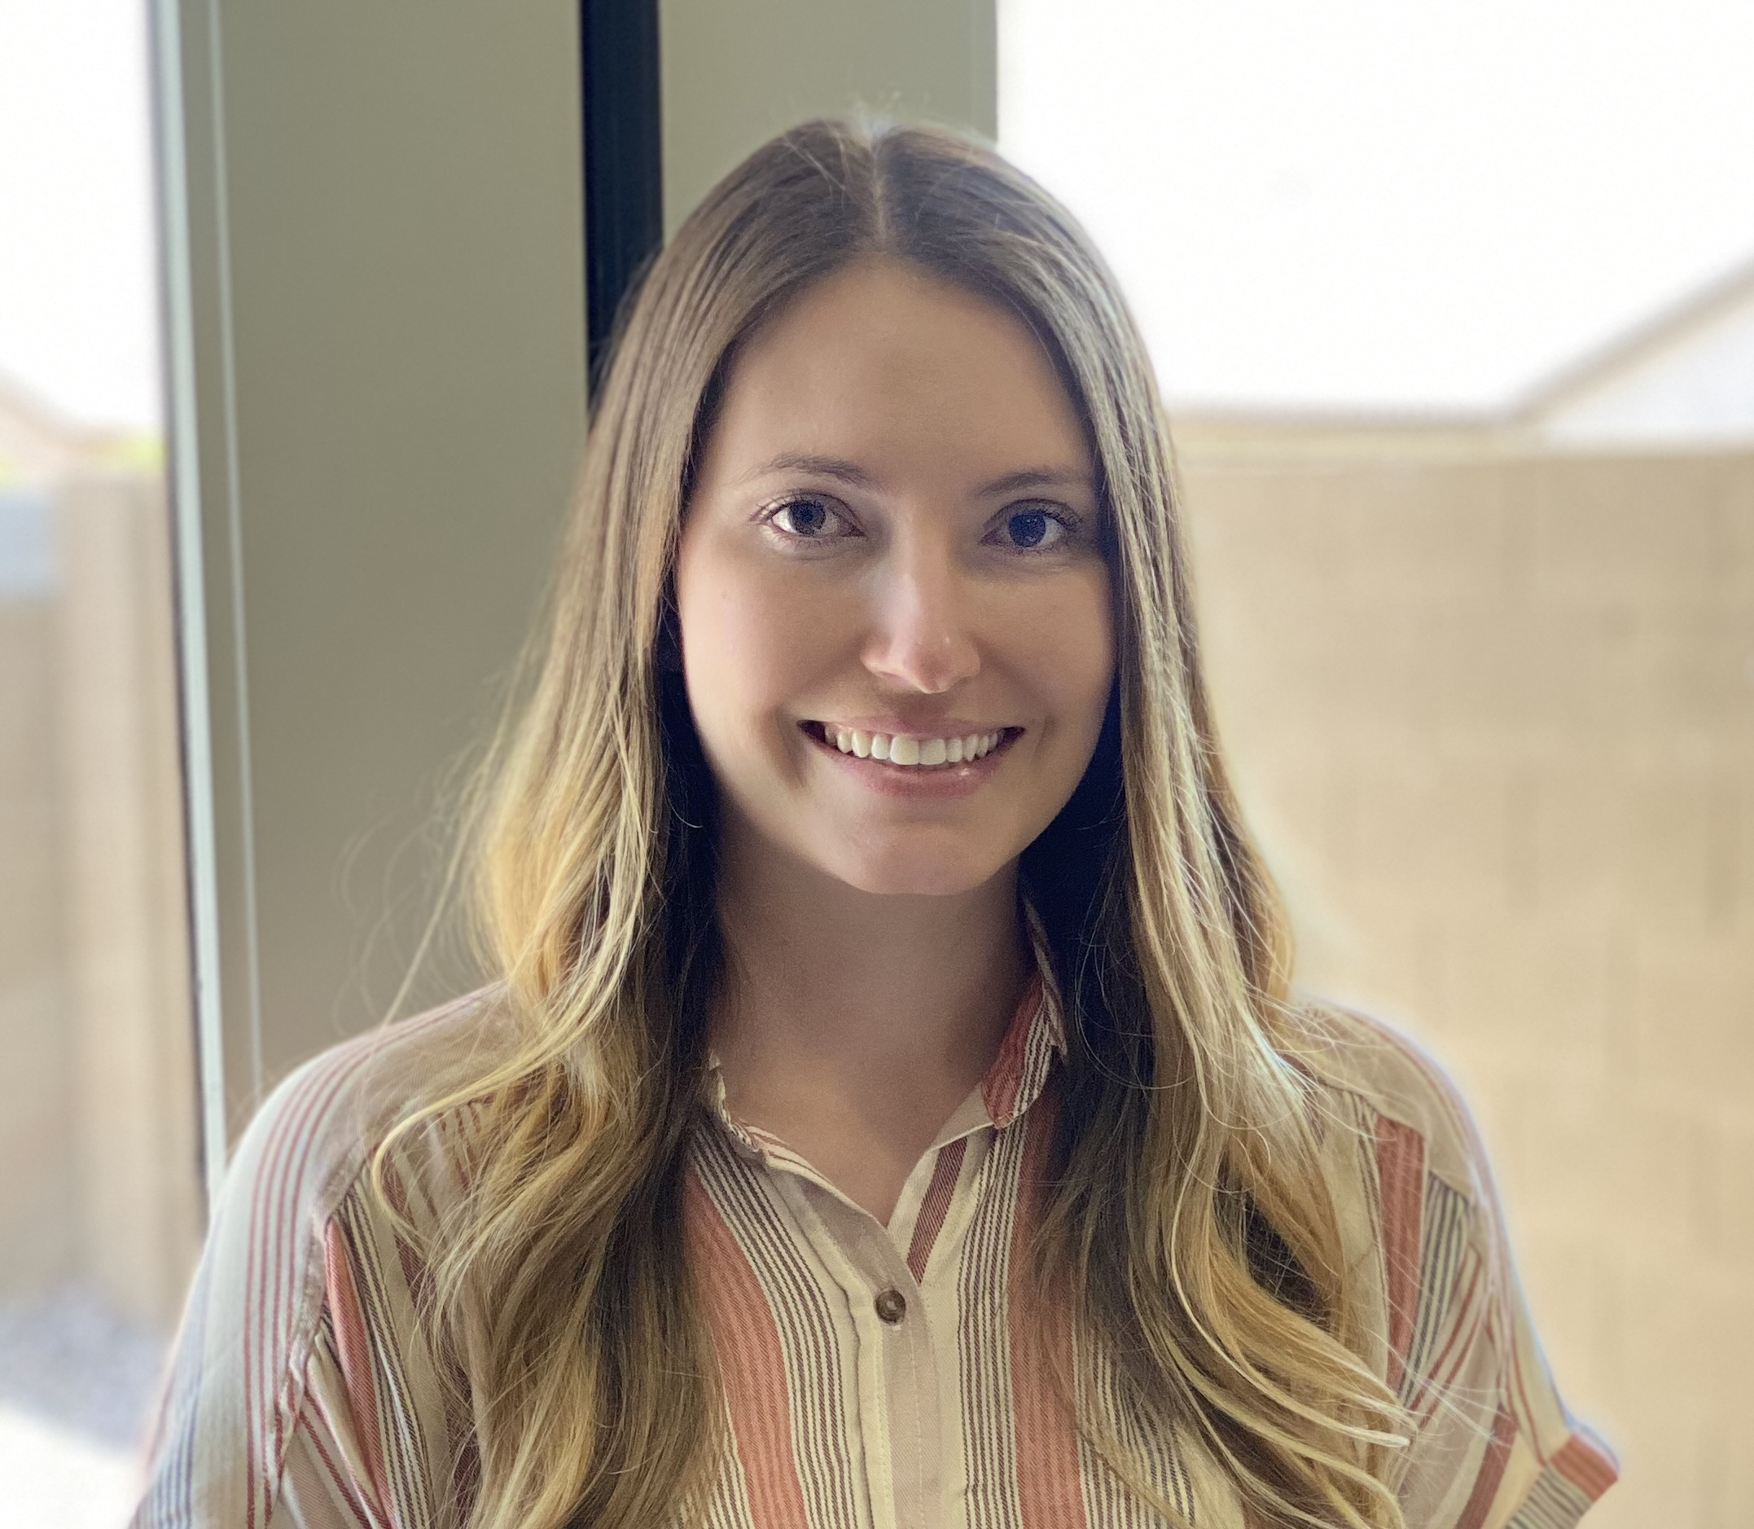
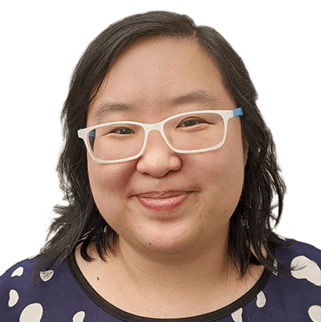
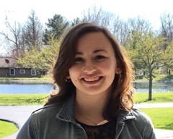
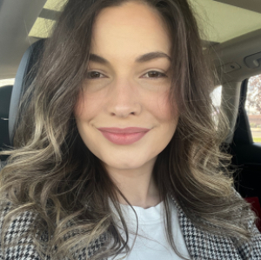
Meet the team
Kristin Wagner
Chief Administrative Officer
Brooke Brown
Operations Manager
Caroline Suh
HR Manager
Sydney Ritson
Operations Administrator
Alaina Sheets
Operations PMC

Slide 10
We Want to Hear from You!
Discussion Topic:
What changes can help the team utilize Nuclino more effectively & efficiently?

