Slide 1


Accelerating Scalability and Efficiency with Containers:
A Deep Dive into Docker and Docker Swarm for Cloud-Native Deployments

Slide 2

Agenda
Introduction to Containers
Anecdotal Discussion Around Where Our Time is Spent
Scaling our Products with Containers
The Benefits of Containers for our Customers
Use Cases and Success Stories
Summary of Goals and Accountability for this Year

Slide 3
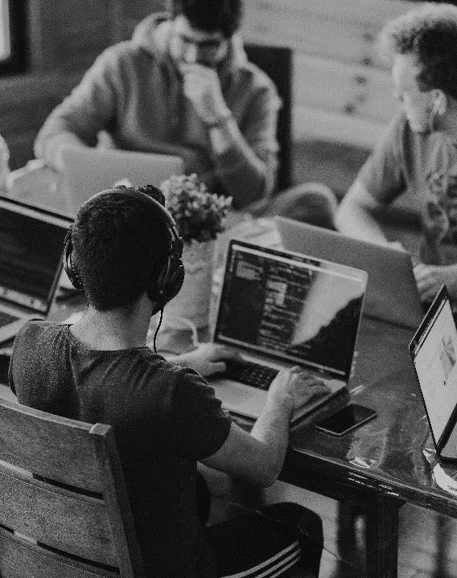
INTRODUCTION
to CONTAINERS
Containers vs. Virtual Machines: A Brief Comparison
  Virtual machines are fully self-contained environments that include an operating system and any required dependencies, running on top of a physical host machine.
  Containers, on the other hand, share the host machine's operating system and kernel, but provide a separate, isolated environment for running applications and their dependencies.
Benefits of Containerization
  Increased efficiency: Containers are lightweight and consume fewer resources than virtual machines, allowing you to run more applications on a single machine.
  Consistent environments: Containers ensure that your applications run in the same way across different environments, making it easier to develop, test, and deploy.
  Portability: Containers can be easily moved between different machines and environments, making it easy to scale and adapt as needed.

Slide 4

Wasted Time
on Environment Related Tasks

Slide 5
Anecdote
a RECENT SURVEY
Approximately 25% of wasted time, or more in some cases, is spent dealing with environment-related issues such as installing dependencies, configuring servers, and troubleshooting compatibility issues.
  This adds up to a staggering number of hours per year per developer - time that could be better spent on developing software and delivering value to our customers.
This is a common problem in the software industry, where the complexity of modern applications and the proliferation of different environments can lead to significant productivity losses.
Fortunately, containerization can help to mitigate these issues by providing a standardized, consistent environment for development, testing, and deployment.
By adopting a containerization strategy using tools like Docker and Docker Swarm, we can free up our developers' time to focus on what they do best: building great software.

Slide 6
Scaling our Products
With containers

Slide 7
The Benefits
of CONTAINERIZATION for our PRODUCT LINE
Consistent, repeatable environments: Containers provide a standardized environment for our applications, ensuring that they will run the same way across different machines and environments.
Faster deployment: Containers can be easily moved between different machines and environments, making it easier to scale up or down as needed.
Reduced infrastructure costs: By using containers, we can run more applications on a single machine, reducing our infrastructure costs and improving our efficiency.

Slide 8






Customer Onboarding
Faster time to value: With containerization, we can quickly spin up new instances of our applications based on the customer's requirements, allowing them to start using our products more quickly.
Improved scalability: Containers make it easier to scale up or down based on customer demand, ensuring that our applications can keep up with their needs.
Greater flexibility: With containerization, we can provide customers with more flexibility in terms of customizing their instances and choosing the resources they need.

Slide 9
A VERY SATISFIED CUTOMER
Efficient and consistent delivery of working software to serve our client’s needs!
=
A Repeat Customer
A VERY HAPPY BOTTOM LINE

Slide 10

Use Cases
And a success story

Slide 11
PayPal &
their CONTAINERIZATION STORY
Paypal, a leading online payment platform, adopted Docker in order to improve their application development and deployment processes. They used Docker to containerize their applications and create a more standardized and streamlined environment for development, testing, and deployment.

Slide 12
The benefits that PayPal experienced from using Docker included:
Faster deployment: With Docker, PayPal was able to deploy applications more quickly and easily, reducing their time-to-market and improving their agility.
Increased efficiency: By containerizing their applications, PayPal was able to reduce their infrastructure costs and run more applications on a single machine, improving their efficiency.
Improved developer productivity: With Docker, PayPal's developers were able to spend more time developing new features and less time dealing with environment-related issues.

Slide 13
SUMMARY
Overall, PayPal was able to achieve significant improvements in their development and deployment processes by adopting Docker and containers.
CITATIONS
https://www.mirantis.com/cloud-case-studies/paypal/
PayPal Manages 200,000 Containers in the Cloud to Speed Transactions
https://www.youtube.com/watch?v=wf4Jg-9gv9Q&list=PLkA60AVN3hh9hh7lbvw_FKS83HRJonv6h&index=4
PayPal Uses Docker To Containerize Existing Apps and Secure Workloads
https://hostingjournalist.com/a-story-of-change-at-paypal-with-docker-enterprise/
A story of change at PayPal with Docker Enterprise

Slide 14
What’s next
LOOKING AHEAD

Slide 15
quarterly timeline
Q1 |  |  | Q2 |  |  | Q3 |  |  | Q4
JAN | FEB | MAR | APR | MAY | JUN | JUL | AUG | SEP | OCT | NOV | DEC
Goal: Containerize CEF and Payhub! |  |  | Goal: A full CI/CD process around Containerization for deployments! |  |  | Goal: Full automation of CEF, Payhub, and Connect! |  |  | Goal: Prototyping K8S, Helm Charts, Kubernetes – fully blended Cloud Native environment!

Slide 16


Goals for q2
CONNECT AUTOMATION
CEF/PAYHUB AUTOMATION
Connect fully automated by the end of Q2 for Production Deployment scenarios.
Connect team trained and proficient on the final draft of the automation process.
Automations ready to accept orders from our Website.
Demo feature for Sales
CEF/PAYHUB deployments have containerization option available for Clarity hosted or Azure deployment scenarios.
CEF/Payhub team trained and proficient on final draft of automation process for CEF/Payhub.
Prototype of automation to fulfill orders online.
Demo feature for sales.

Slide 17



ACCOUNTABILITY for q2
NOW
You know the goals!
NEXT
We implement!
LONG-TERM
We execute!
We hold accountable!

Slide 18

SUMMARY
Containerization is the future!
Most major corporations are using docker or some form of containerization!
We can get more work done!
All the benefits mentioned before will allow us to get more work done! Focusing more time on development, and less time on environmental issues!
We can deliver more for our customers!
There is no limit to how far we can scale this!
Keep them coming back for more!
Through consistent output of working software, we can keep our customer long-term, coming back for more and more of what Clarity can offer them!

Slide 19



THANK YOU
Ben F. Swindle
+1 (405) 882-4128
Ben.Swindle@claritymis.com
www.CLARITY-VENTURES.com

