Slide 1


Selenium automated testing
Automated Testing for core functionality

Slide 2

Agenda
WHAT IS SELENIUM
HOW DOES IT WORK
WHAT ARE THE BENEFITS
WHEN SHOULD THIS BE USED FOR PROJECTS
CLOSING

Slide 3

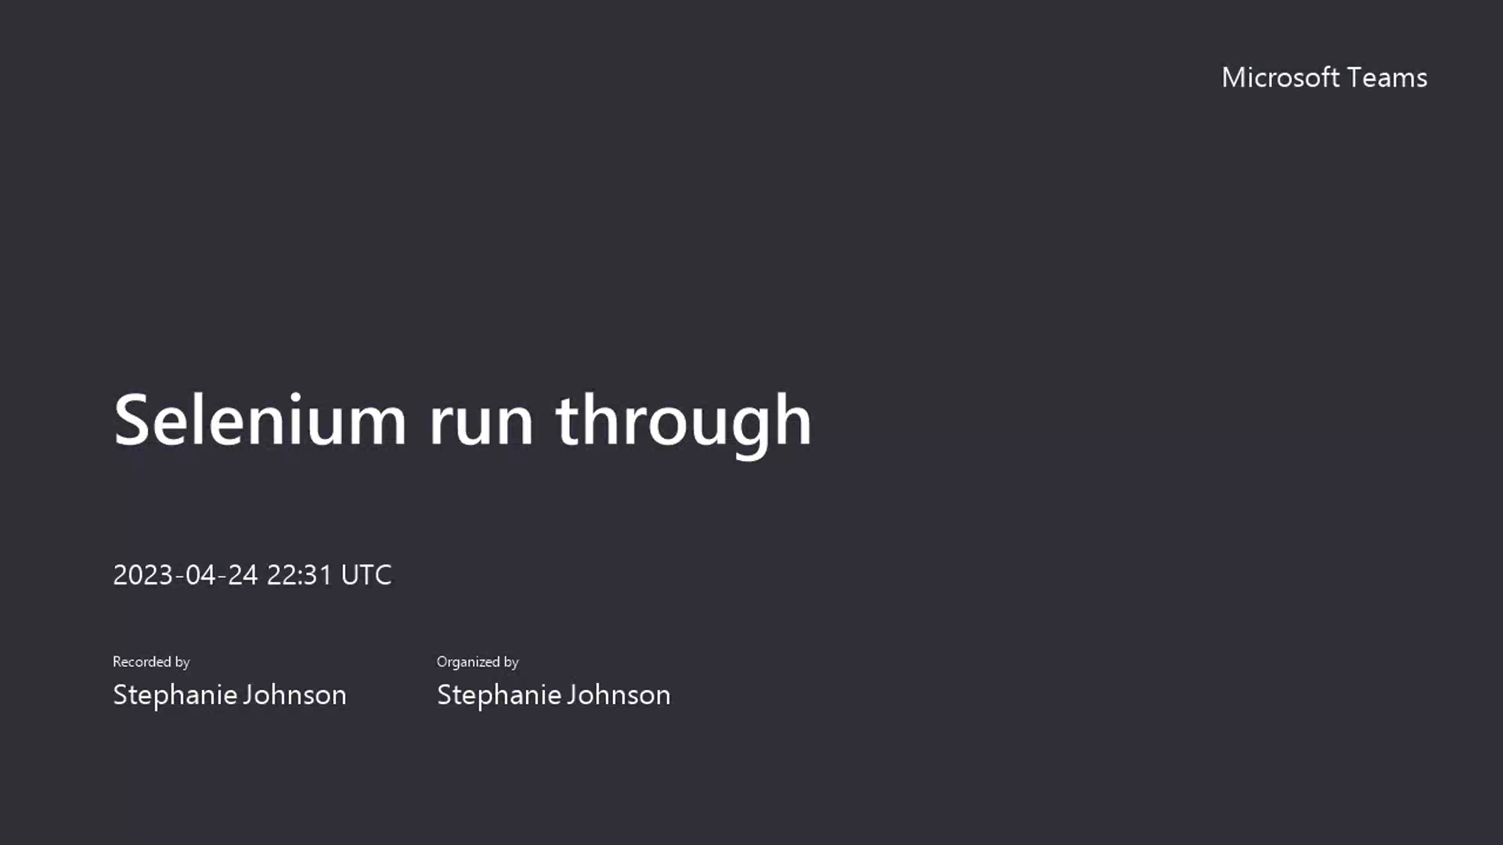
sELENIUM
AUTOMATED TESTING SOFTWARE
Selenium is set up to automate core functionality happy path testing. This test suite will run through registration and login, navigating to products, removing and adding an item to a cart, viewing the cart, running through the full check out process of any project it is assigned to, and viewing the order in the user dashboard. This is also set up for bidding functionality within the CEF auction platform.

Slide 4

How does it work
Let’s Dive In

Slide 5
What are the benefits
Ensuring we are delivering working software after each Deployment
Automation for everyone to validate happy path each sprint
Ensuring customizations do not break core functionality
Error reporting on exactly what is failing
Easy to implement IDs for customizations across projects
Custom tests that can be designed for each project
Less time spent in QA
Increased internal reporting and communication
Above all – Increased client satisfaction.

Slide 6
When should this be used
 | End of Sprint review | Large or functional PRs | When Client Reports issue on prod
Cadence | Every 2 weeks at the end of a sprint | Whenever a PR is published | As soon as the report is received
Who does it? | PM or QA team | The developer/author | Project Management
Where do the results go? | Project Dev Chat and tickets in ADO | Project Dev Chat and tickets in ADO | Project Dev Chat and tickets in ADO

Slide 7
A SATISFIED CUSTOMER
While Selenium is currently only set up for happy-path on core functionality, it is easily customizable to every project in our portfolio. This will allow us to quickly identify breaks and resolve them in a timely manner.
What is the net result of delivering working software every time?

Slide 8

When can we start?
LOOKING AHEAD
All IDs have been added on the new release. We can start this with all net new projects and can start right away with ROCK because selenium ROCKS!

Slide 9
Q&A with the team
Questions?
Justin Sacco -
Front End Development Manager
Stephanie Johnson -
Director of Project Management

Slide 10

THANK YOU
Justin & Stephanie
Team Automate Everything!

