Slide 1


Payment Hub Overview
Ron Halversen & Jeremy LaRose
5/6/23

Slide 2

Birth of Payment Hub
How did we “come” into a Payment solution?
Kevin Hurd @ PayTrace
Competitive need

Slide 3

INTRODUCTION
What is Payment Hub?
Payment Hub is a payment solution that allows anyone to process invoice / credit card payments
It integrates with ANY ERP, CRM, EMR
It integrates with ANY payment gateway / processor
It can be embedded in ANY design, web portal

Slide 4






Target Audience
Direct
  Clients looking an invoicing solution
  Clients looking to swap out their payment gateway
In-direct
  Partners looking for the same for their clients
Leveraged Sales Model

Slide 5

Market Fit
There is over $25 TRILLION a year in B2B, still being paid in paper checks
EVERY company is looking for “cheaper” payment processing
EVERY customer is looking to get their NET Terms paid for faster
EVERY Payment Partner is looking for that integration / competitive edge

Slide 6

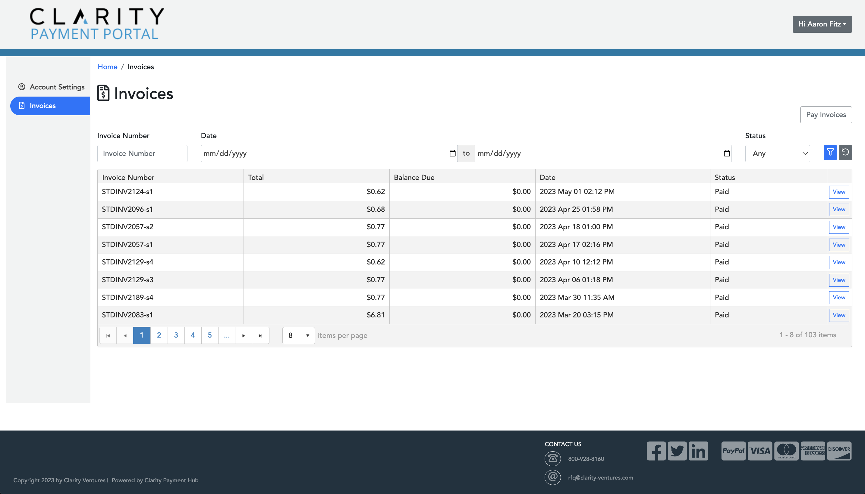
Product Demo
Payment Portal
Virtual Terminal
Quick pay
Batch Capture

Slide 7


Opportunity
DIRECT OPPORTUNITIES
PARTNER PRIORITIES
Basis points (Clarity is a Nuvei ISO, soon to be PayTrace)
Clarity gets 85% of every payment fee
Embedded payments (CEF, Payment Hub, Donation, Bill Pay, etc.)
Setup, Monthly Support & Hosting fees
Every partner has clients that need integration
Every partner can “cut” us in on basis points
Each partner has MANY sales reps, ISOs, Resellers, etc.
Every partner MAY purchase our book of business (21X)

Slide 8

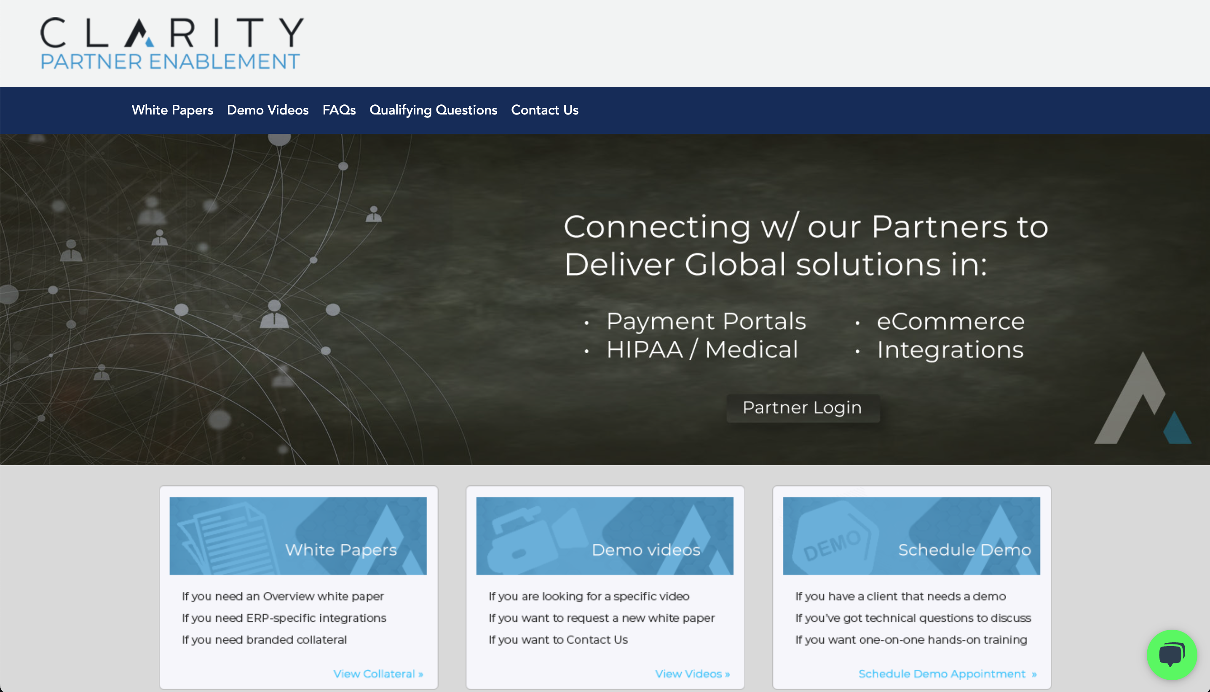
Partner Portal Demo
White Papers
Demo Videos
FAQs
Scheduling

Slide 9

THANK YOU
Ron Halversen
Jennifer Polito
Tyler Wiener
Partners.ClarityDemos.Com

