Slide 1


Artificial intelligence And Clarity
Chris Reddick & Jeremy LaRose

Slide 2

Agenda
An Overview of AI and How It Works
Our Execution Plan with AI
Tools and Libraries
Augmenting Our Day-To-Day Work

Slide 3

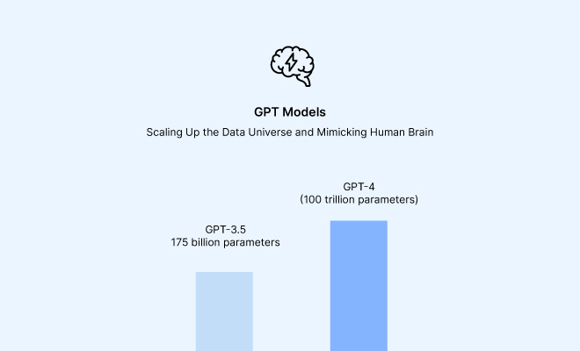
How Does AI work?
A Brief Glimpse
Understanding AI/Machine Learning:
https://www.youtube.com/watch?v=bfmFfD2RIcg

Slide 4

Artificial intelligence
Let’s Dive In

Slide 5
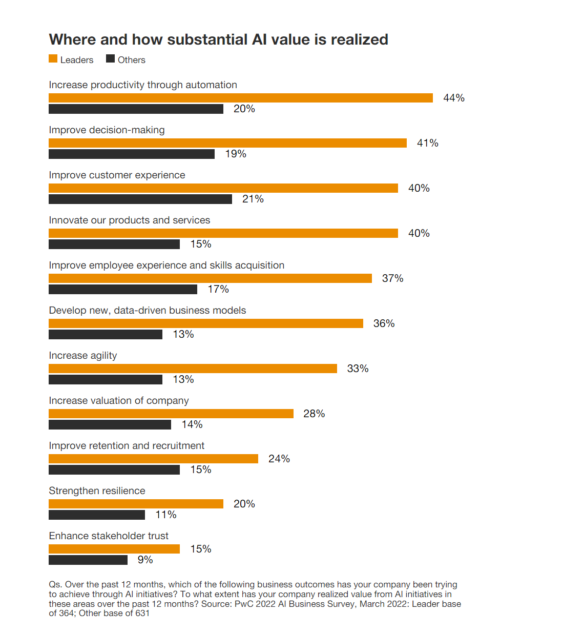
Rapidly advancing technology

Slide 6

David shim, ceo of read.ai
Former Ceo of Foursquare
It won’t be a surprise to see in the next 24 months, multiple billion-dollar companies built on top of OpenAI’s foundational models. The startups that will be the most successful won’t be the best at prompt engineering, which is the focus today, rather success will be found in what novel data and use case they incorporate into OpenAI’s models. This novel data and application will be the moat that establishes the next set of AI unicorns.

Slide 7
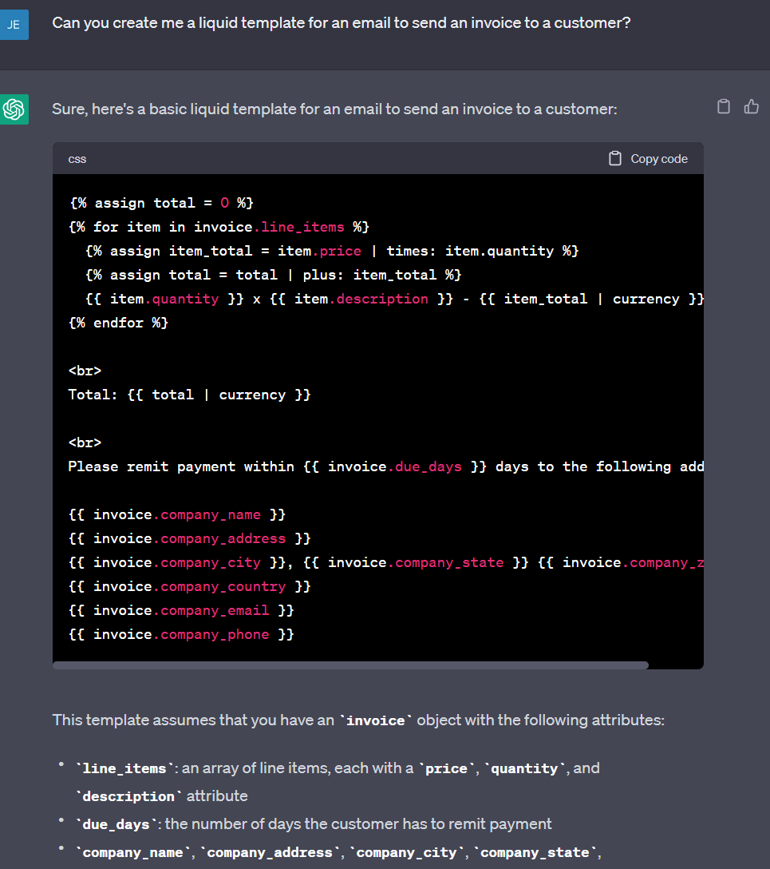
What’s next
LOOKING AHEAD

Slide 8
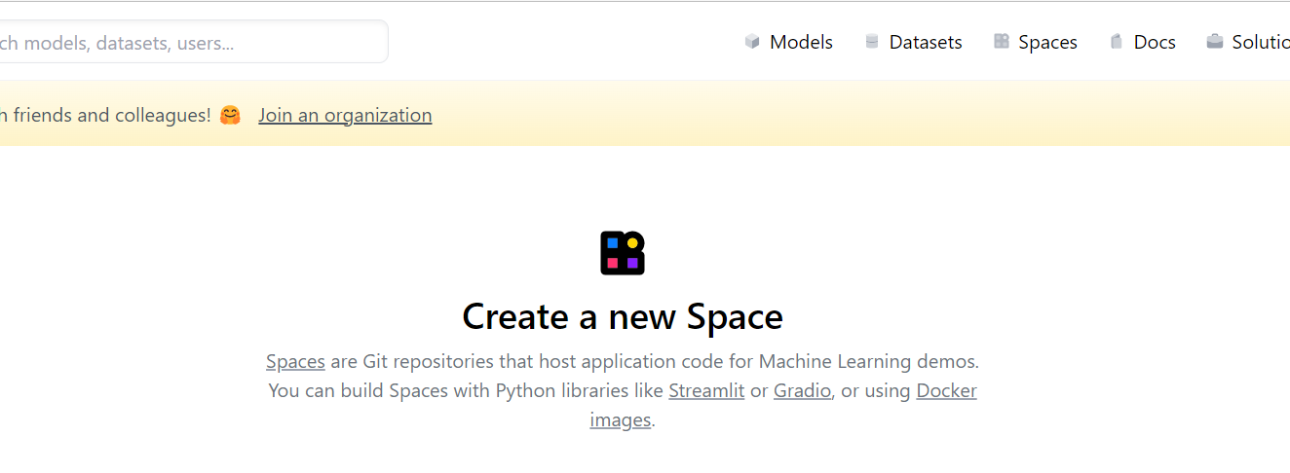
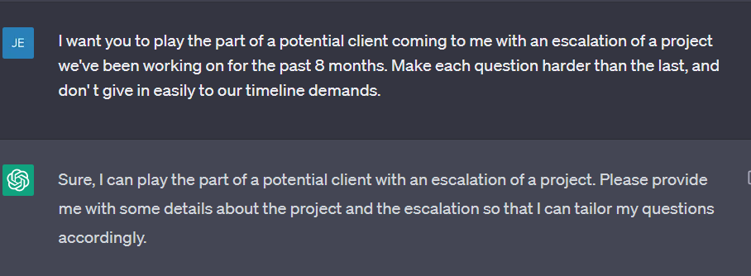
EMBRACING the EVOLUTION
AUGMENTED WORKFLOWS
BUSINESS PRIORITIES
Consider how to utilize AI in your day-to-day
Breaking developments weekly -- new tools developing rapidly
Creativity is king
First-mover competitive advantage
Automate repetitive tasks
Form a partnership with the tooling available
Creating your personal assistant
Adding the tool to your kit

Slide 9
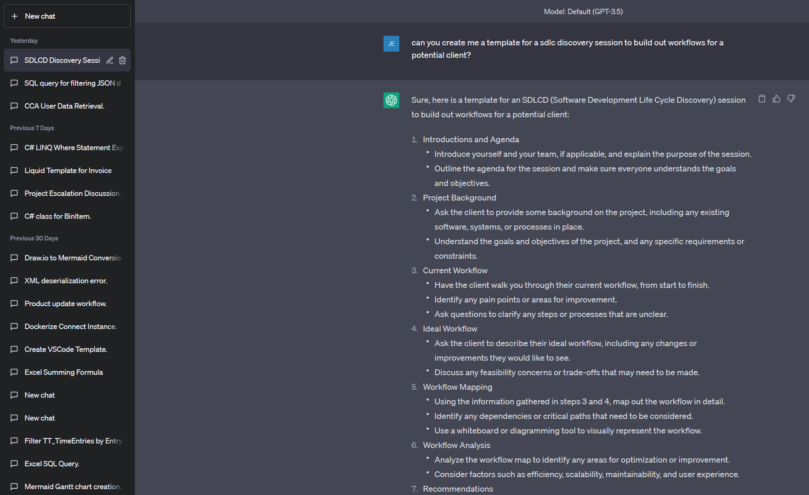
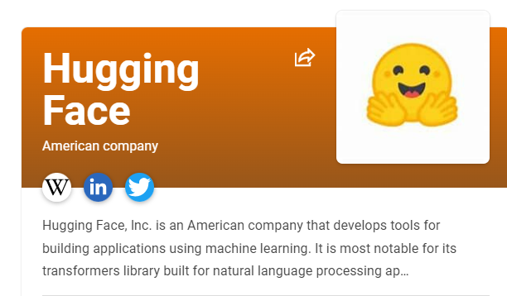
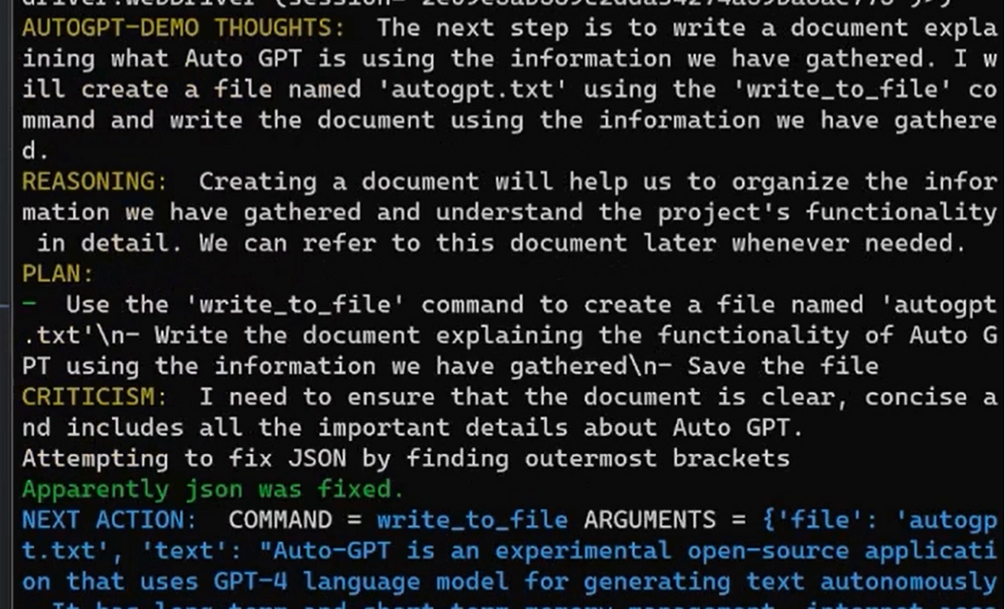
Tools and libraries
ChatGPT 3.5/4
https://chat.openai.com
The main prompt-engine tool itself, with plugins coming soon.
Paid subscription option for better access and GPT-4
Power is in the prompt – prompt engineering takes center stage
HUGGING FACE
https://huggingface.co
The one-stop shop for AI tooling
Community-driven tools
Host models, tools, or datasets
Auto-GPT
Built upon ChatGPT APIs, uses looping and reasoning to solve problems in chunks.
Utilizes creation of AI Agents which prompt themselves, rather than user input
Connected to the internet, but will burn tokens very quickly

Slide 10
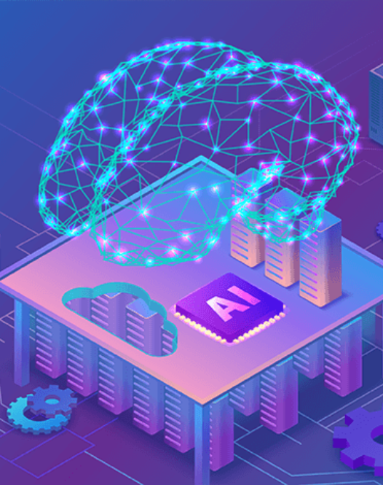
SUMMARY
AI IS EVOLVING RAPIDLY
The Clarity AI Team is dedicated to staying on top of the latest breakthroughs and applications. Clarity’s AI Server is available for team members who are interested (4x A100 GPUs :D)
THE ADVANTAGE WILL GO TO THE EARLY MOVERS
By diving into tooling and integrating it into our products, we can gain a competitive advantage.
BUILDING THE NEXT GENERATION OF TOOLS
Opportunities exist both in adding AI to our products and the creation of new tools to drive business practices.

Slide 11
THANK YOU
THE CLARITY AI TEAM

Slide 12


